Slide 1

k-NN

Slide 2
Objective
To classify a cancerous cell is “Benign” or “Malignant” based on the size of its nuclei.
We train a model based on our dataset which contains data of 569 cancerous tumors, classified as benign or malignant.
We decide which variables has the most effect on classifying the cancer as Benign or Malignant, so if a new patient data comes in, then we can predict if the cancer is benign or malignant by looking at those few variables.
Procedure
The first feature is an ID number, the second is the cancer diagnosis, and 30 are numeric-valued laboratory measurements.
Our hypothesis is that cancerous tissues have larger nuclei.
We will test our hypothesis by implementing kNN algorithm on the Wisconsin Breast Cancer data in R.
We also check for different values of ‘k’ where k is no of classes to be included to support our hypothesis.

Slide 3
What is k-NN
Lazy learning
KNN is a Non-parametric, Lazy learning algorithm. Its purpose is to use a database in which the data points are separated into several classes to predict the classification of a new sample point.
Non-parametric
tests are also called distribution-free test because they don't assume that your data follow a specific distribution.
is a learning method in which generalization of the training data is delayed until a query is made to the system, as opposed to in eager learning, where the system tries to generalize the training data before receiving queries.

Slide 4
Organizing the data, create training and validation sets
Deciding k
Generally k get decided based on the square root of data points , i.e. say we have 100 data points we start with ‘k=10’
Later this k can be changed, but square root method is a good start for assigning ‘k’
Normalization
We have different ranges for data points, i.e. some can be between 0-10 while other can be between 100-1000, so to get some uniformity in our data we need to normalize it.
Here the we use the simple function below to normalize our dataset,
y <- (x - min(x))/(max(x) - min(x))
Training and validation sets
Similar to deciding the k value, we can split out dataset into two sets by any fraction based on the complexity of modeling method and messiness of the data, here we use 2/3 for training and 1/3 for validation.
We need to careful that the distribution is uniform in both sets.

Slide 5
Executing k-NN
Create Sets
Create training and validation sets by splitting the dataset.
Normalize
Normalize data to get all class values in a uniform range.
Find k
Find ‘k’ by taking square root of number of cases.
Implement
Run algorithm with the value ‘k’. Test for different values of ‘k’.

Slide 6
Here we test for different values of k.

Slide 7
We see the significance for different parameters.
We see that values for radius_worst, perimeter_worst, points_mean and points_worst are highest overall.
And values for texture_se, smoothness_se, symmetry_se, dimension_mean and dimension_se are almost negligible on comparing the data.

Slide 8
Cross Validation
K – Fold Cross Validation
It divides the N data points into k mutually exclusive subsets of equal size. The process then leaves out one of the k subsets as a validation set and trains on the remaining subsets. This process is repeated k times, leaving out one of the k subsets each time.
Monte Carlo Cross Validation
It simply splits the N data points into the two subsets training set and validation set by sampling, without replacement. The model is then trained training set and validated on validation set.

Slide 9
Monte Carlo Cross Validation
You randomly select (without replacement) some fraction of your data to form the training set, and then assign the rest of the points to the test-set. This process is then repeated.
Here we are creating 1000 random subsets of equal size to perform validation to determine how the performance of the variables variates. We will calculate the mean error to observe the variation.
Q. But why to do this after variable significance has been determined?
This is performed to validate the variable significance that we have observed earlier. After Monte Carlo Cross Validation we may find that most significant variables found earlier might have different impact on our model than what we thought (i.e the impact may increase or decrease during validation)

Slide 10
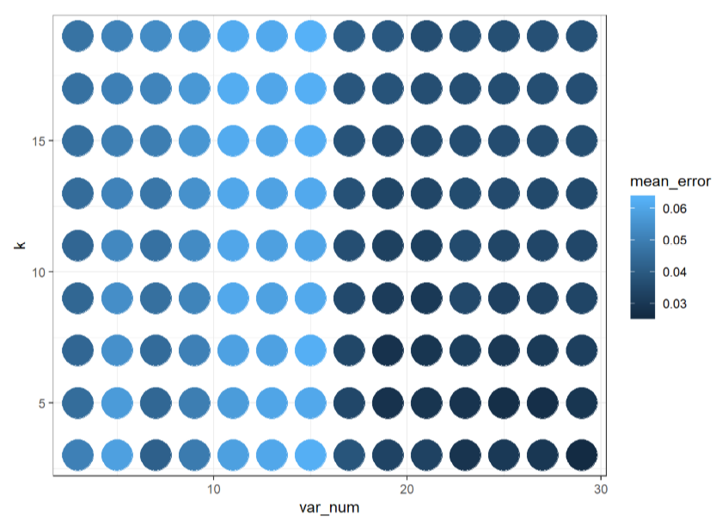
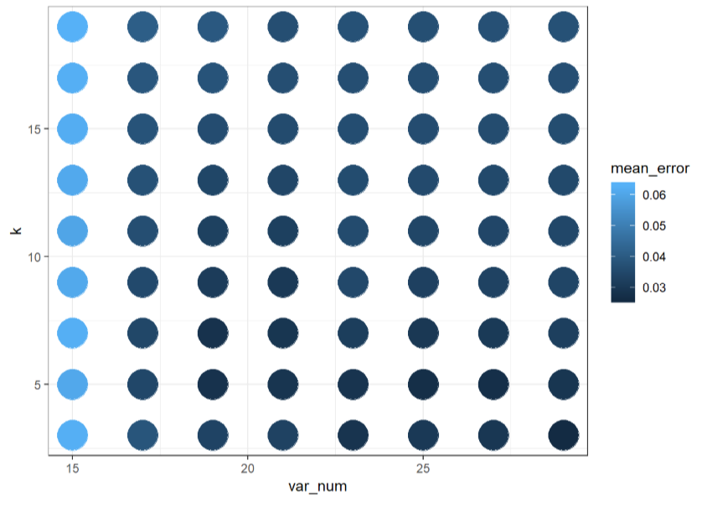
Monte Carlo Cross Validation
We are checking for values after 15 till 30 variables.
The algorithm performs not that well with less than 10 variables and high k, it is worse between 10 and 15 variables but then it gets better for higher values of k.
It looks like 21 variables and more with a low k works best.

Slide 11
Steps in Cross Validation
Finding Optimal k
Using rule of thumb, the square root of the size of the reference set 15.91~16
So we take the value of k from 3 up to 19, incrementing by 2 using seq function
Optimal set of variables- Taking sets of variables starting from 3 up to 29, incrementing by 2 using seq
Getting performance stats
For all combinations (n,m) of variable numbers and values of k, we subset the data.frame to the records with var_num = n and k=m.
Then we compute the mean of the error variable over these records using "ddply"

Slide 12
Steps in Cross Validation(contd.)
Survey of Parameter Performance
We check the mean error value for k in(3,5,7,9,11,13,15,17,19) taking different number of variables (17,19,21,25,27).
It looks like 21 variables and more with a low k works best
Validation of Final Test
We Compute the error in validation set using the training set as a reference.
Validation error was computed to be 0.04233 which means it is comparatively a very good output than rule of thumb.

Slide 13
Conclusion
With the application of kNN Classification and Monte Carlo Cross validation on Wisconsin breast cancer data we were able to select the variables which would most accurately predict the cancer cells to be Benign or Malignant

Slide 14
By
Ruchi Moondra
Pranab Singh
Piyush Patel
Pranav Pawaskar

